Slide 1

EMOTIONAL HEALTH AND WELLBEING FOR YOUNG PEOPLE
CHILDREN’S EMOTIONAL HEALTH & WELLBEING
A GUIDE FROM THE
MENTAL HEALTH SUPPORT TEAM

Slide 2
Aims and Objectives
To understand What Mental Health is?
Who are the Mental Health Support Team?
Types of Mental Health difficulty
Notes:
What are we going to cover with this session:
Introduction to the MHST
Understanding mental health
Identifying potential indicators of mental ill health
Our aim is to bridge the gap between Education and Healthcare.

Slide 3
Mental Health Support Team
(MHST)
Access
Work across schools and colleges to provide better access to specialist mental health services.
Work with YP
Offer short term evidence-based interventions to children and young people on a one to one or group session basis (via parents in primary school settings)
Parents/ Careers & Teachers
Offer sessions to Parents and Teachers to raise awareness of mental health difficulties and explore ways to support children and young people.
Notes:
MHST work in teams across Nottinghamshire. These teams consist of EMHPs who are supported by senior team members from a range of professional backgrounds including Mental Health Nurses, Social Workers and CBT therapists. EMHP’s also have a variety of different background – expand
We want to engage parents and teachers in conversations about mental health so that children feel able to talk adults about how they are feeling.

Slide 4

What is Mental Health?

Slide 5
Mental Health
We all have mental health. Mental health is about our feelings, thoughts, emotions and our moods. Looking after our mental health is just as important as looking after our physical health.
We all have small feelings every day: These sometimes feel strong and overwhelming, whether happy or sad, but they go away before too long.
Sometimes we experience big feelings: These feel strong and overwhelming and last for a long time. They stop us doing what we want to do in our lives.
Notes:
Just like physical health, we all have mental health. It’s about our thoughts, feelings and emotions.
We all go through difficult times, and it can be a healthy reaction to feel negative emotions when facing challenges.
Our genetics, upbringing, environment and life experiences all affect our mental health and influence how we think and respond to challenges and opportunities. There's no single "right way" to react.
Being aware of how challenges in life can affect our mental health may make it easier to understand when we, or someone we care about, are struggling.

Slide 6
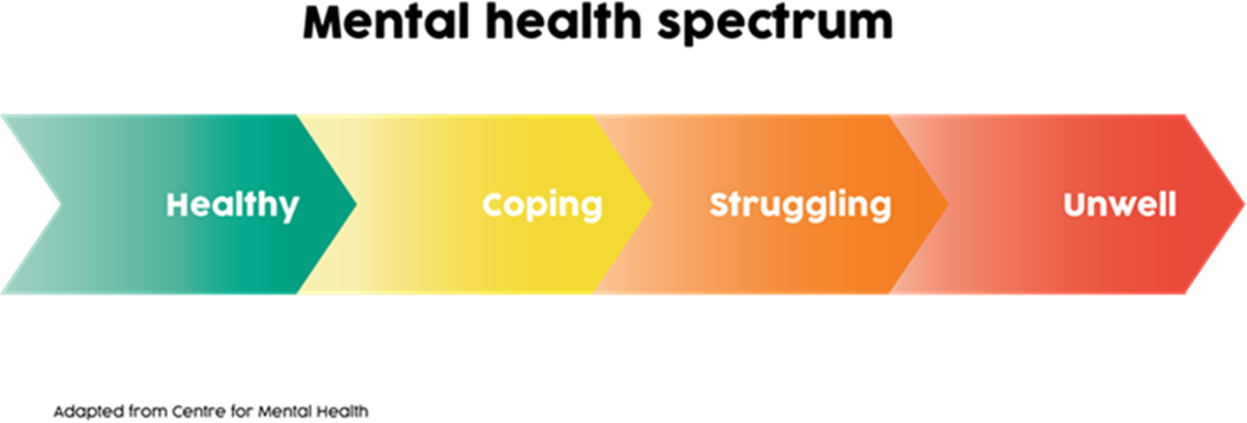
Notes:
At any one time, a child or young person may be anywhere on a spectrum between being healthy and unwell. Many children move along the spectrum at different times.
Having good mental health doesn’t mean being happy all the time but being able to manage difficulties when they arise.
It’s important that we:
Feel connected
Are active
Look for something good in each day
Have Confidence and assertiveness
Set goals

Slide 7
1 in 10 young people will experience a mental health problem.
That is around three students in the classroom, so mental health problems are likely to affect most children, whether they experience it or their friends do.
It is known that over 50% of mental illness starts before the age of 14
and 75% by the age of 18.
70% of young people who have experienced a mental health problem, say they have had negative reactions from their friends.
Notes:
Talking about mental health with children is really important: if they’re aware of what mental health problems are, it will help them to understand their own wellbeing and what’s going on with their family and friends.
It can be difficult to know how to start the conversation but being open about mental health will help children in the future.
It may be helpful to think about ways that these conversations could be implemented into the school day???

Slide 8
Types of mental health difficulty
Phobias
Social Anxiety
Depression
Panic Attacks
Panic Disorder
Separation Anxiety
Body Dysmorphic Disorder
Generalised Anxiety Disorder (GAD)
Obsessive Compulsive Disorder (OCD)
Post-Traumatic Stress Disorder
Notes:
We are now going to look at types of mental health difficulties that can affect children

Slide 9
Anxiety
Difficulties in separating from home/caregiver that would not be proportionate for their age.
Persistent worries about specific things, or anything and everything
Persistent reluctance or refusal to go to school.
Catastrophising
Difficulties sleeping
Notes:
There are many different types of anxiety; commonly for primary aged children this could be separation anxiety, GAD or a specific fear/phobia

Slide 10
How to recognise Anxiety in children
Frequent complaints such as stomach aches when there is no physical reason
Excessive crying
Reluctance to try new things or do things independently
Becoming easily frustrated or angry
Avoiding doing things they used to enjoy
Notes:
There are many different types of anxiety; commonly for primary aged children this could be separation anxiety, GAD or a specific fear/phobia

Slide 11
Anxiety Parenting
Course
Parent/Carer
Managing Anxiety with your child group (MAC Course)
- 5 sessions
- 2 phone calls
- The course focuses on fears, worries and anxiety, including what anxiety problems typically look like, how they develop and step–by-step techniques to help your child to overcome their worries.
Notes:
If you feel like anxiety might be becoming a problem, we offer a group for parents/carers to help you to support your young people.

Slide 12
Challenging Behaviours
Frequent tantrums
Refusal to do anything that is asked
Arguing or bargaining
Unable to cope when they don’t get their own way
Aggressive
Notes:
All children misbehave and test the boundaries at times. But sometimes behaviour can become a difficulty with signs such as:

Slide 13
Behaviour Parenting Course
Parent/carer
Forever Families Course
- 8 sessions of 1.5 hours
- 1 review phone call
- The aim of the course is to equip parents with strategies for managing behaviour including the use of positive praise, rewards, limit setting and consequences, whilst promoting their child’s social and emotional competence
.
Notes:
If you feel like behaviour might be becoming a problem, we offer a group for parents/carers to help you to support your young people.

Slide 14
SEND Anxiety Parenting Course
Parent/carer
SEND Anxiety Course
- 6 sessions of 1.5 hours
- 1 review phone call
- The aim of the course is to offer support and strategies to support your child or young person in managing their anxiety. The group has been designed specifically for children and young people who have a special education need, which includes Autism, ADHD and learning disabilities..
Notes:
A confirmed diagnosis is not essential to take part in the group.
During the six week group, we will cover topics such as behaviour, emotions, sensory difficulties, communication and physical sensations.
We hope that by the end of the six sessions, you will be able to:
Understand how anxiety may present
Recognise when your child is anxious
Understand what has triggered their anxiety
Have the confidence to help them manage it

Slide 15
Sleep
The sleep workshop for primary aged pupils and their parents is a one-off workshop that lasts one hour.
The aim of the workshop is to explore:
- The importance of sleep for our bodies and minds
- How much sleep is really needed
- Tips and tricks to help parents support with difficulties around sleep
- strategies to help the young person to have a healthier sleep routine.
Notes:
Parent workshop and primary aged workshop- parents now offered as a video

Slide 16
Low mood/
Depression
Depression occurs in 1-3% of children, and 4-5% of adolescents
(Thapar et al., 2012)
How to recognise low mood in children:
Irritability.
Vague physical complaints, sad facial expression, poor eye contact.
Running away from home, decline in school work.
Failure to make expected weight gain rather than losing weight, appetite may increase or decrease.
Social withdrawal and inability to enjoy life.
Disturbed sleep.
Notes:
Not as common in younger children and is often a sign of something else troubling them. However, it might be seen:
Irritability can be defined as proneness to anger. Both behavioural and emotional components.
Developmentally inappropriate temper outbursts.
Grouchy mood.
Aggression only behavioural manifestation.

Slide 17
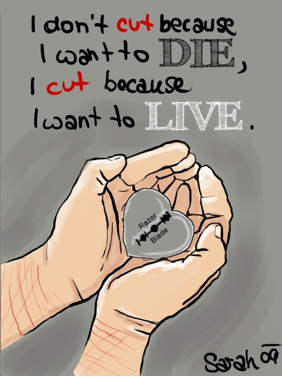
What is Self-harm?
Self-harm is when someone intentionally damages their body causing harm or injury.
It’s usually a way of coping with or expressing overwhelming emotional distress.
Generally speaking the intent is not to end life but:
To express distress
To express something that they find hard to say.
To turn invisible thoughts and feelings into something visible.
To change emotional pain to physical pain.
Notes:
Mental health and particularly Self-harm is often not spoken about due to fear… fear of stigma

Slide 18
Suggested self-sooth techniques
Distraction bag
Visit self-help websites or use an app
Colouring or puzzle books
Scribble on paper with a red crayon or pen
Hitting a pillow/cushion or boxing bag
Take a minute to breathe and relax
Writing down thoughts or feelings that are distressing then crumpling up the paper or tearing it up and throwing it away.
Squashing and squeezing play-doh
Listen to music or watch a film

Slide 19
Suicide
An estimated 1 in 5 of us have had suicidal thoughts at some point in our lives.
Asking if someone is suicidal will NOT put the thought into their head – FACT!!
In fact talking openly decreases the likelihood they will act on their feelings.
We know it is hard, but having open conversations is really important!
Try to remain calm, listen and show empathy
Notes:
Suicide decriminalised in 1961.

Slide 20
Tips for Supporting your
Child’s Mental Health
Starting a conversation
“You don’t understand”
Non-judgemental approach
Don’t try to fix it; encourage them to come to their own solutions
Drive the VAN – Validate, Acknowledge and Normalise
Say what you see
Me and you vs. the problem, not me vs. you
Talk about others and their mental health
Car conversations
The take away messages: “thank you for sharing”, “I’m here for you”, “I love you and nothing will ever change that”
Notes:
Tips for Supporting Your Child’s Mental Health
These tips can be for temporary or enduring mental health challenges. But it all starts with opening up a conversation, so here are some tips on how…
You Don’t understand
How often have you heard this?
One of the most common comments we hear, “my parents don’t understand” / coupled with parents who are desperate to understand.
Parents are expected to know everything but Its okay not understand. They are the experts in them and how they feel, everyone experiences the difficulties differently
Send the message: “Even if I don’t understand, know that I want to”
Non-Judgemental Approach
Judgement = withdrawal.
Be mindful of what is being said indirectly, expressing judgement about others’ mental health could be a barrier to your child opening up.
Don’t try to fix it; encourage them to come to their own solutions
It’s natural for parents/ carers to want to try and make them feel better (e.g. grazed knee = plaster), but a solution isn’t necessarily what they need
By encouraging them to come to their own solutions you’re teaching them problem solving and reinforcing the message they can cope. If you try and solve it for them = “this is too big, I cant cope with strong emotions, I need parent/carer to fix it for me”
Try; “that sounds really difficult, what do you think will help?”
I you think it is appropriate to give advice, ask first. Giving people unsolicited advice activates their threat system, social dominance = withdrawal and disengagement. Ask: “is it okay if I share what I think will help” “I know someone who experienced something similar, can I share with you what helped them?”
Ask: What can I do to help?
Be with them, sometimes it isn’t a solution they need at all, just to express their emotions, to feel safe whilst they do and to be comforted. Instinct of parents can be if they’re sad you want to make them happy, sometimes its okay just to be sad and be with them as they are. They may just need a tea or a cuddle or someone to watch a Netflix series with whilst they’re sad on the sofa. Acceptance can be more helpful and powerful than resisting or trying to change it. (bad hour, bad afternoon, bad day, bad week), riding the wave can sometimes be the best approach.
VAN
Acknowledge: Acknowledge what they are saying, paraphrase it back to them, indicate you have heard them and you’re listening
Validate: Validate their emotions; they are real, they are important. If it is important to you, then it is important to me. Remember, it’s not the size of the problem that it is important, it is the size of the impact. (e.g. “it’s just hormones” or “just a petty argument with a friend”. Examples: “That sounds really tough”, “I can see that has really upset you”
Normalising: Communicating that what they are feeling is normal. Lots of young people won’t open up because they are worried something is “wrong” with them. We want to communicate that emotions are normal; sadness, fear, anger. And relating that back to other young people and even your own experiences where appropriate. Examples; “you’re not alone”, “I felt like that before”.
Say What You See
Just like CatchPhrase – describe what you observe, it can be used to start a conversation or during. E.g. “I can see you haven’t been going out much recently”/ “I can see that, that bothers you”. It allows the young person to fill in the gaps, you know there is something up, this gives them the space to expand without us presuming.
Me and you vs. the problem, not me vs. you
Common parents say they try to open a dialogue and it results in an argument and they don’t remember how it escalated
If they are struggling with their mental health - They’re swimming in a sea of emotion, you’re on dry land, don’t step into the sea! – don’t be drawn into an argument or conflict about it, it just widens the gap. young people can project their emotions and it can be a symptom the difficulty to push people away (e.g. low self-esteem or low mood)
Can be helpful to externalise and see the emotional difficulty as separate from the young person and who they are “it’s not who they are, it’s something they are going through or battling”. They are a young person experiencing an emotional health difficulty, they are not an emotional health difficulty, in the same way that someone is not “diabetes” if they have it, or something more temporary and fluid like a “bad leg”.
You’re on the same team
Talk about others and their mental health
Sometimes young people will test by talking about their friends or someone on the telly to gage your thoughts; use that as an in or start the conversation this way yourself.
It’s a great way to demonstrate your non-judgemental approach, send the message “it’s safe to talk to me about this” and to drift into talking about them.
Starting the conversation in a neutral and non-threatening way
Example: “X was talking about how sad they felt after X, I can relate to that, have you ever felt way?”
Car Conversations
Starting the conversation in situations where you don’t have eye contact. Facilitating a non-threatening environment with minimal distractions. There’s something to the old Freudian sitting on the couch looking away approach. (e.g. walks, car journeys etc.) Can feel more natural and easier for them to talk.
The Take Away Messages
When finishing a conversation you want it to end well with the opportunity for more in the future
“thank you for sharing” – it delivers the message “I value your trust”
“I’m here for you” - One of main reasons I hear for young people not sharing is that they do not want to be a burden, they see parents are busy, they see they have their own problems. They don’t want to be another ‘problem’, they need to know their parents/ carers are there and always will make time for them.
“I love you and nothing will ever change that” – because we can never hear that enough can we.

Slide 21
Tips for Supporting your
Child’s Mental Health
What can I do?
Don’t blame yourself!
Be a role model
Talk openly about mental health in the home
Encourage and demonstrate wellbeing habits; connect, be active, be curious, keep learning and give.
1:1 time
Communicate
Notes:
Don’t Blame Yourself
Many parents ask ‘why’ their child might experience emotional difficulty or blame themselves, in reality there is very rarely a single reason but a combination of factors creating a perfect storm.
Blame serves little purpose, understanding can help but self-criticism can act as an obstacle to moving forward.
However because of your substantial impact the are opportunities to improve the situation by your example
Be a role model
talk about your own feeling, label them, encourage emotional language in the home and demonstrate how you are coping with difficult emotions = normalises
Look after your own mental health. Airplane mask analogy. The best thing you could possibly do for your child’s mental health is look after your own. For various reasons, 1. they will interact if both of you are struggling. 2. They will learn from, if you demonstrate practicing coping, seeking support they will learn that too. If you need support, don’t hesitate to ask for support.
Encourage positive habits
Particularly in the pandemic
1. Connect; With family, friends, colleagues and neighbours. At home, work, school or in your local community
2. Be active; Exercising makes you feel good. Link between physical and mental health
3. Be curious. Catch sight of the beautiful. Remark on the unusual. Notice the changing seasons. Savour the moment, whether you are walking to work, eating lunch or talking to friends. Be aware of the world around you and what you are feeling. Reflecting on your experiences will help you appreciate what matters to you.
4. Keep learning; Try something new. Rediscover an old interest. Sign up for that course. Take on a different responsibility at work. Fix a bike. Learn to play an instrument or how to cook your favourite food. Set a challenge you will enjoy achieving. Learning new things will make you more confident as well as being fun.
5. Give; Do something nice for a friend, or a stranger. Thank someone. Smile. Volunteer your time. Join a community group. Look out, as well as in. Seeing yourself, and your happiness, linked to the wider community can be incredibly rewarding and creates connections with the people around you.
1:1 Time
It builds relationships
Projects the message that they are worthy
It creates opportunities to have conversations
Strong parental relationships acts as a big protective factor for resilience, preventing mental health difficulties and recovery
Communicate
Speak with others around the young person, school, other services. Work as a team around the young person. They exist in systems, sometimes it is about how those around them respond more than what they have to do or change.

Slide 22
“Sometimes my parents can spot if I’m struggling before I do, it helps if they look out for changes”
“Our parents are human and we drive them up the wall, but it hurts when they say things like ‘don’t use that (mental health) as an excuse’. When you express an opinion they say ‘don’t talk back’, but I’m trying to express how I feel. It’s like my feelings aren’t valid.”
“My parents were really supportive but they didn’t know how to deal with my emotions.. I needed a break, a hug, to know everything will be okay and do things with me they know I like to do”
“Every time my parents did something, it is wrong - They were trying and it wasn’t their fault, it felt this way because of how I was feeling”
“When I am not showing signs of anxiety, they expect me to be normal, sometimes I physically can’t and expectations feel too high, especially on top of everything else like school and revision”
What do children and young people say?
“There’s always a reason behind the behaviour, I think it helps to understand that”.
“Sometimes I just need some time alone and to feel supported”
“Sometimes the kid doesn’t know the answer, you don’t need to solve the problem, just try to understand and be there without judgement”.
“I just needed to know they’re there”
“It’s the little things that help; watching a film together, offering me a cookie! Sometimes talking about it is too hard”
Notes:
We asked young people what they wished their parents knew when they were struggling with their mental health and here are their tips:

Slide 23
Tips for Supporting your
Child’s Mental Health
Online Resources
For Parents
https://youngminds.org.uk/find-help/for-parents/
https://nottalone.org.uk/?a=pc
Mental Health Support for Adults
https://www.nottinghamshirehealthcare.nhs.uk/nottingham-city-and-county
https://www.trentpts.co.uk/self-referral
Self-Referral to CAMHS
https://www.nottinghamshirehealthcare.nhs.uk/camhs-self-referral
MHST CAMHS - Mental Health Support Teams | Nottinghamshire Healthcare NHS Foundation Trust
Notes:
If you feel that you or your child need support, please speak to your MHL in school to refer to the MHST or self-refer by visiting our website
CAMHS - Mental Health Support Teams | Nottinghamshire Healthcare NHS Foundation Trust

Slide 24
Tips for Supporting your
Child’s Mental Health
Recommended Reading
Infant and Primary
Helping Your Child with Fears and Worries - Cathy Creswell
Starving the (anxiety, depression, stress, anger or exam stress) Gremlin – Kate Collins-Donnelly
You’re a Star/ Don’t Worry be Happy/ Be Strong / Be Yourself / Be Brave / Sometimes I’m Anxious – Poppy O’Neill
The Incredible Years - Webster-Stratton (for behaviour that challenges)

Slide 25
When should you get support?
A referral to the MHST might be helpful if…
It’s having an impact on their life
You’ve spoken to school about what other support has/can be put in place
You’ve explored any possible underlying problems with your GP such as physical health problems
You’ve spoken to your child and they want support
You have a specific goal or target area in mind e.g. sleep

Slide 26

Take home messages
What will you take away from today’s session?
Notes:
1) What will you continue doing?
2) What will you start doing?
3) What will you stop doing?

Slide 27

Q & A
Does anyone have any
Questions they would like to ask us at this time?
Notes:
There will be the opportunity at the end if you have any questions you would like to ask in relation to our service.
Caveat: Please do not share any personal information as we are unable to discuss Individual children or cases
Please liaise with teachers/members of staff should you require any further support or information

Slide 28
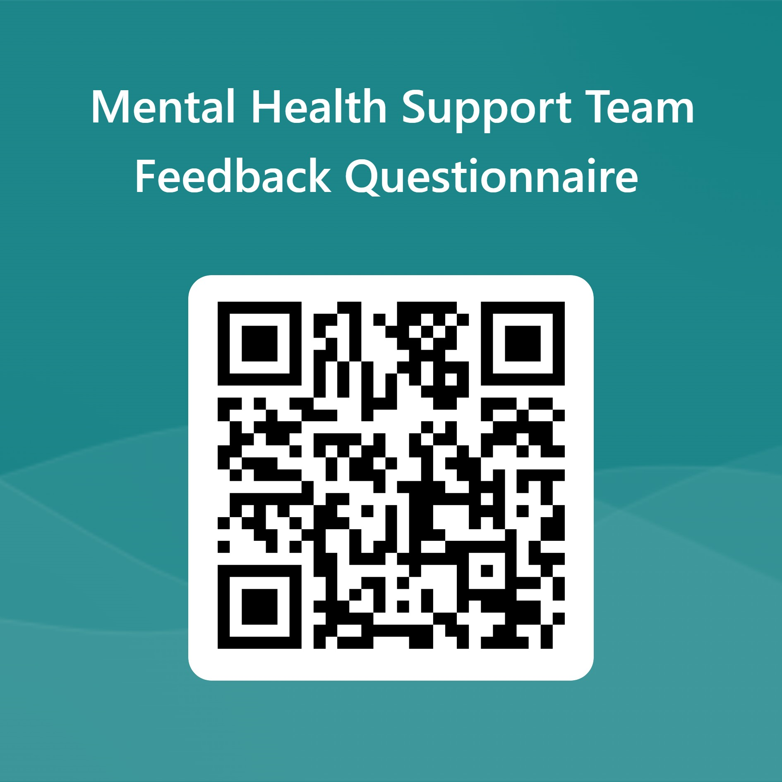
Feedback
Your feedback is very important to us, so we can improve and continue to meet the needs of parents and carers.
Please take 5 minutes to feedback on today’s session by following the link below or opening your phone camera to the QR code below
https://forms.office.com/e/tbuQBuf7V3

