Slide 1


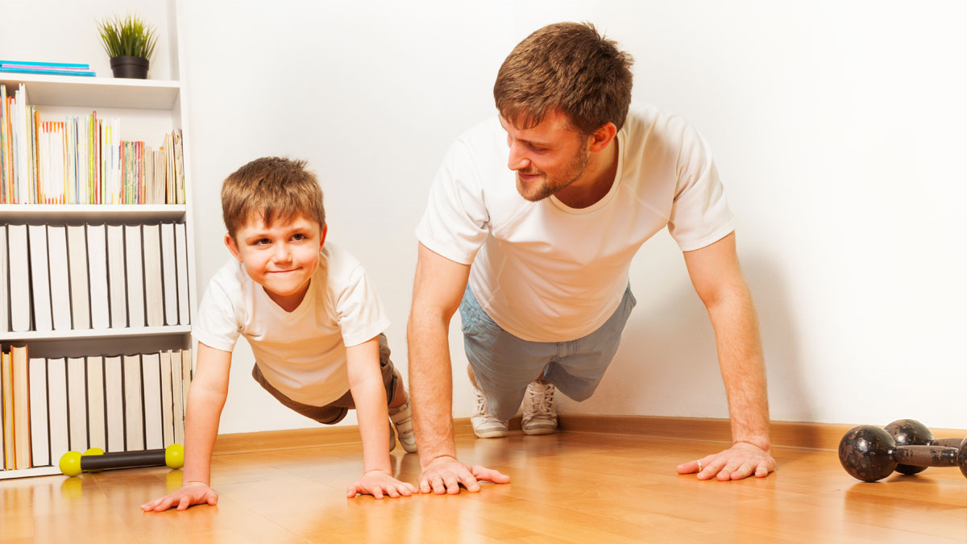
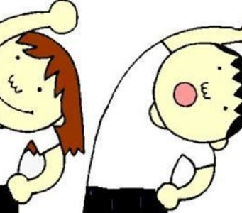
Premier League Primary Stars
PE @ Home

Slide 2
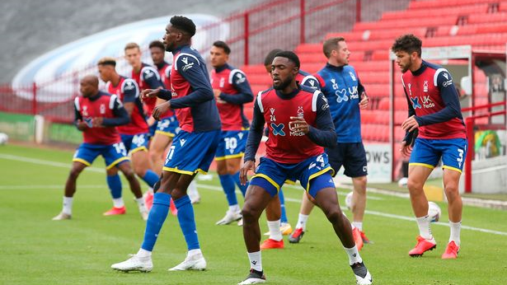
Let's get warmed up!
Remember, warming up correctly is key to a successful lesson!

Slide 3
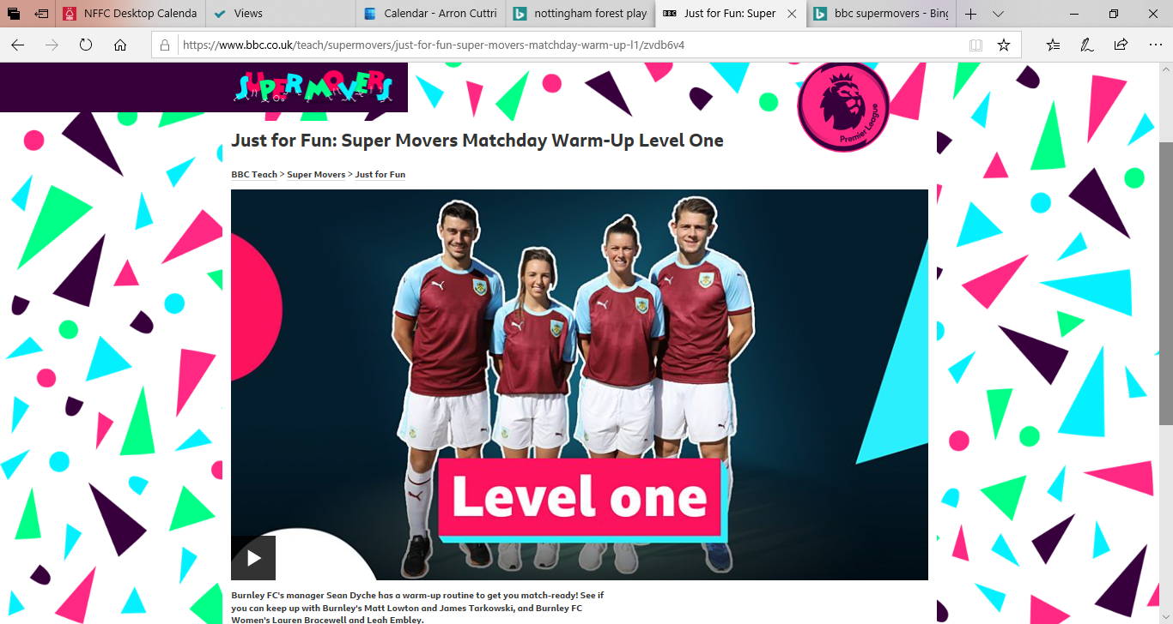

Slide 4
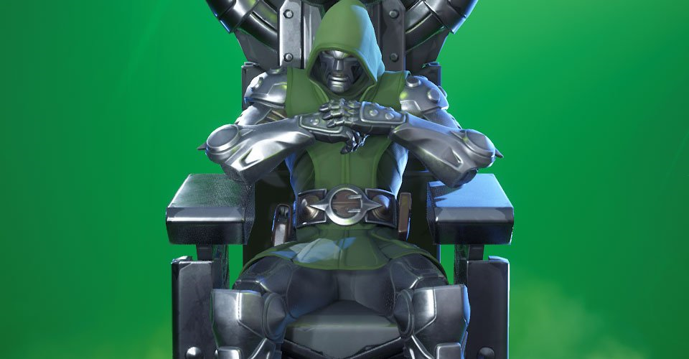
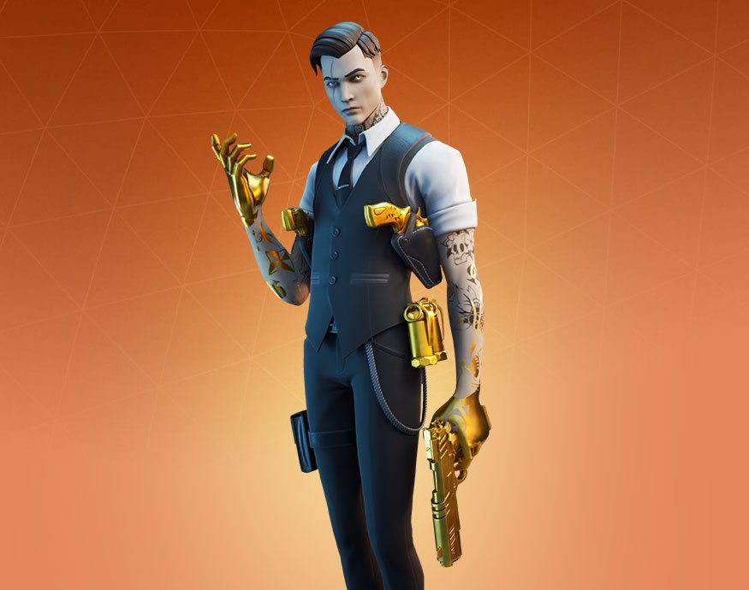
Learning Objectives
In todays PE @ home lesson, you are going to take part in the worlds biggest and best game….Fortnite!
Your task as Fortnite superstars, is to create a dance routine using Fortnite emotes which will blow the likes of Midas and Doctor Dooms away.

Slide 5

FORT-NITE FEVER
FORTNITERS!!
On the next two slides are a selection of Fortnite emotes from the game.
Move the mouse over the pictures and click the link to show you how to perform each move.
Once you have viewed them all, select your favourite six emotes and put them into a routine.
You must perform each move for 6-8 seconds to impress the judges.

Slide 6


Remember its not a race, take your time performing each move (perform an emote for 6/8 seconds)
Count yourself in ready to move to the next emote so the transition is smooth and looks like you’re the ultimate Fortniter
Practice makes perfect, build each step up one emote at a time until you have got it right. (Midas is the Simon Cowell of the Fortnite world)
This CC BY-SA-NC
This Photo by Unknown Author is licensed under CC BY-NC-ND

Slide 7
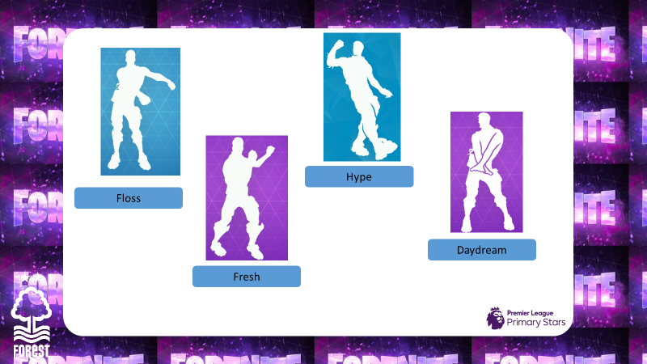

Slide 8
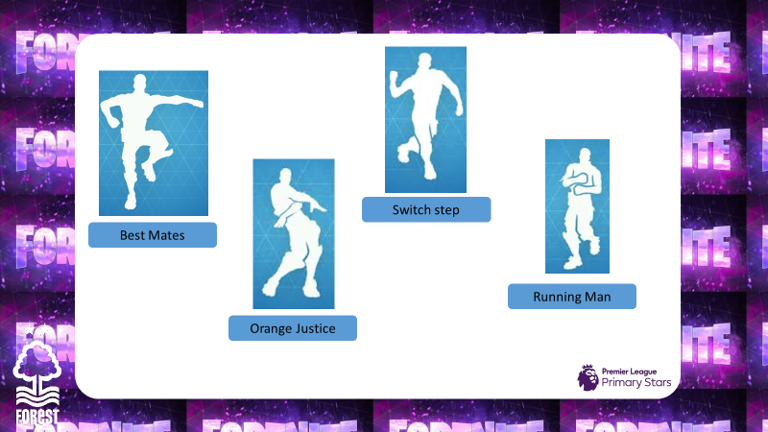


Slide 9

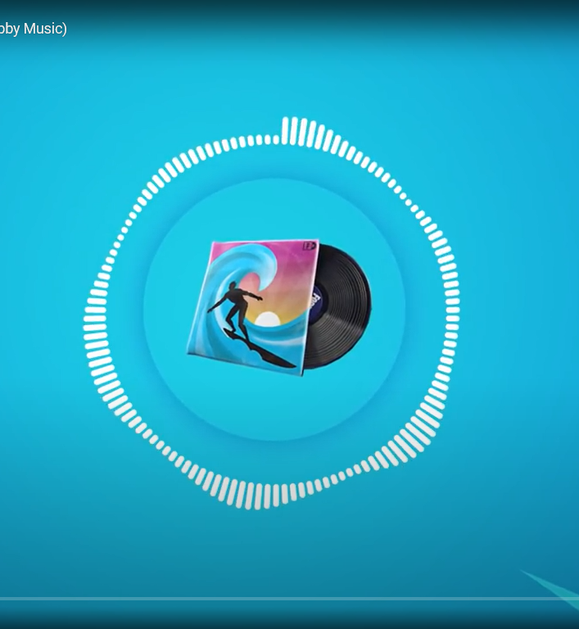
This CC BY
To help you choose your emotes, you may want to choose a song from the games lobby that may decide how fast/slow you should perform each move

Slide 10
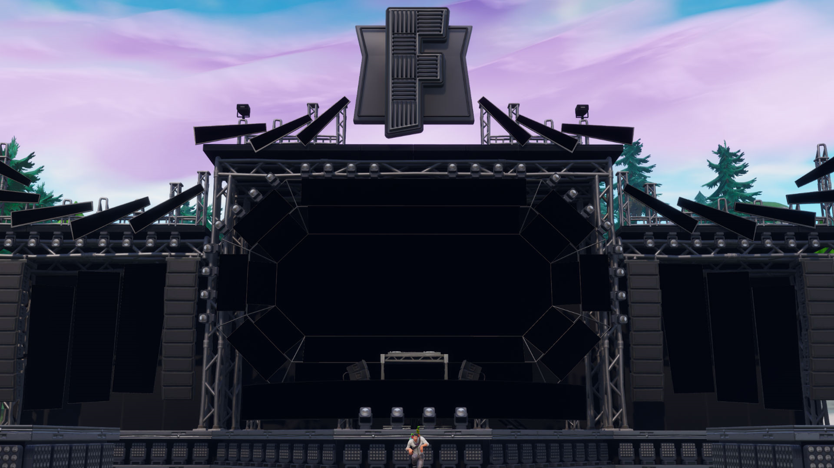
OVER TO YOU
The stage is set and ready to see your ultimate Fortnite dancing

Slide 11
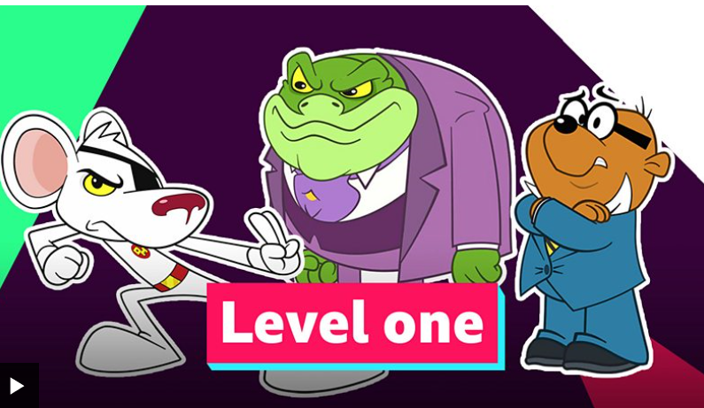

Slide 12
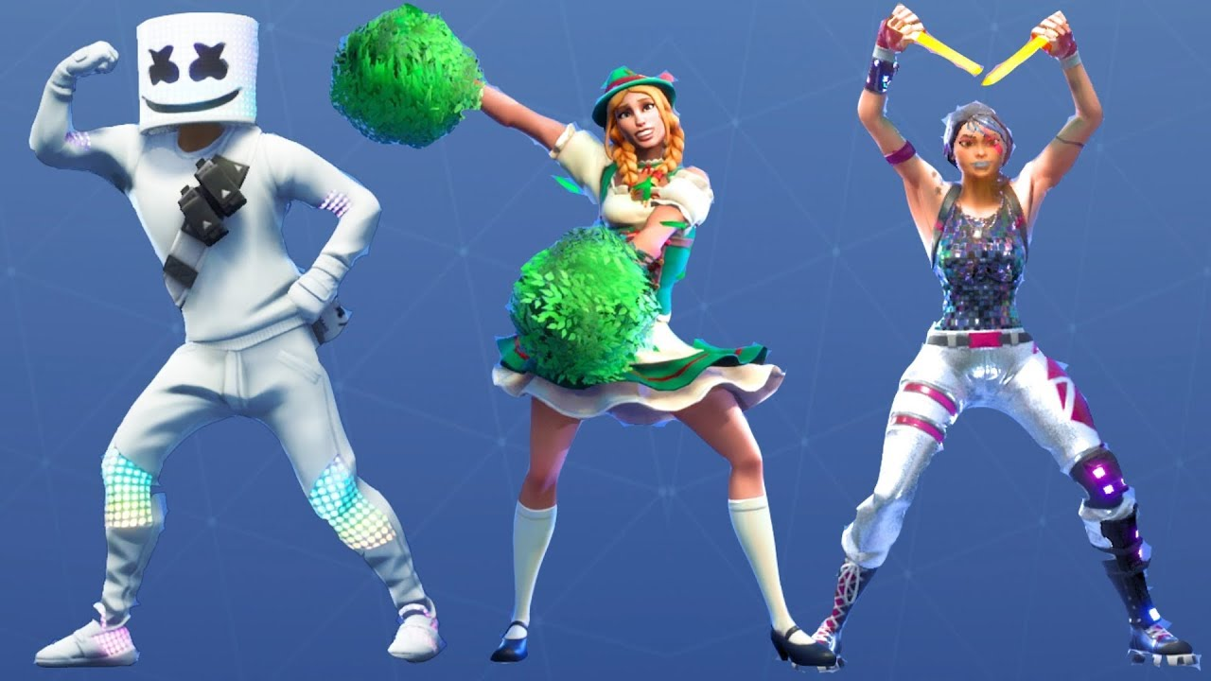
WELL DONE YOU WERE BRILLIANT!!
I’m hearing you scored 10’s all round, the judges were impressed!
Remember to keep active as best you can, its important we aim to get one hour of exercise a day, try the links below to keep you active while at home
https://www.youtube.com/watch?v=Kyv9iJf0gT8
https://www.youtube.com/watch?v=Rizij3icAOU

