Slide 1

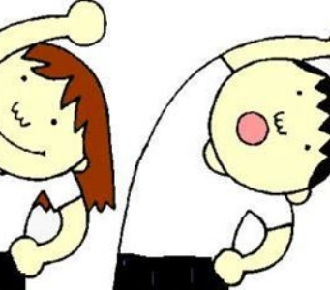

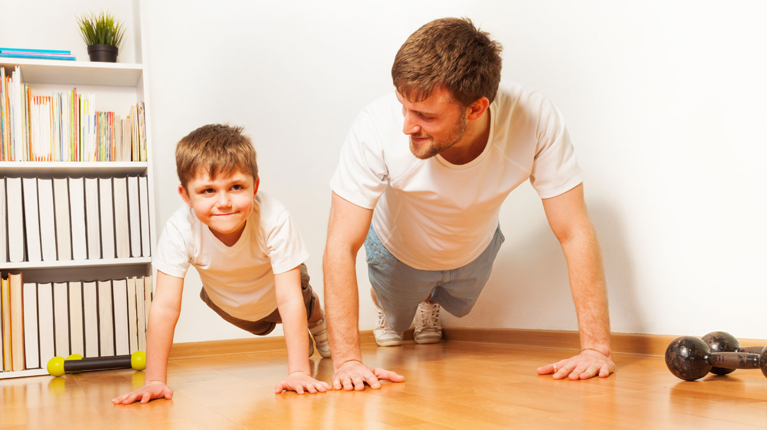
Premier League Primary Stars
PE @ Home

Slide 2
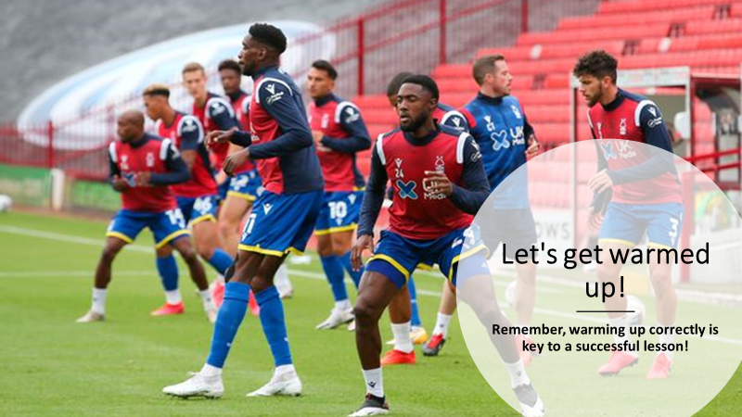

Slide 3
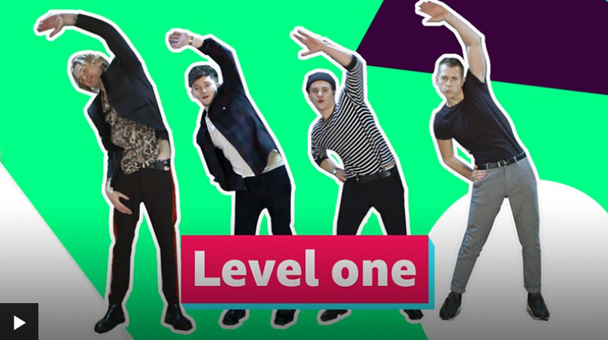

Slide 4

Learning Objectives
In todays PE @ home lesson, you are going to take part in some of Disney's biggest and best movies….High School Musical & Hannah Montana
You have been tasked at becoming Disney’s latest back up dancer for the new movies.
Your task is to learn dance moves from certain songs of the High School Musical and/or Hannah Montana which will blow the likes of Troy and Hannah away.

Slide 5

Remember its not a race, take your time performing each move and make sure you perfect it before moving on.
Practice ALWAYS makes perfect, make sure you try your best and rewind the video if you need to.
Your challenge is to build up the routine till you can eventually dance without stopping at any point!
Good luck Wildcats

Slide 6
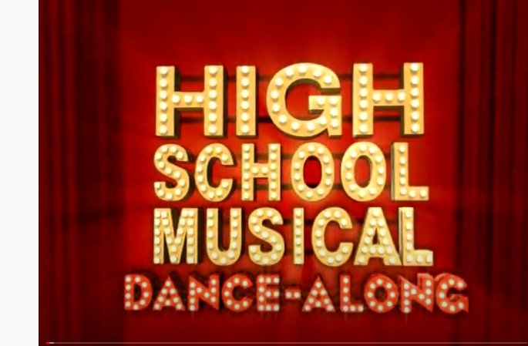
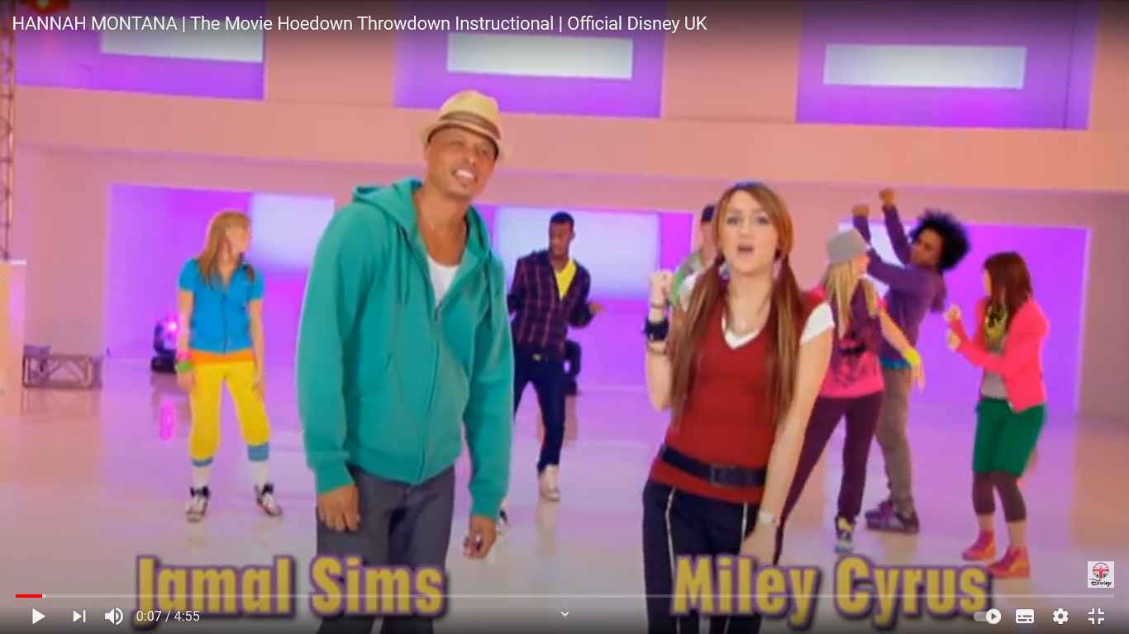
Okay Wildcats and Montana’s
Move the mouse over the pictures (right) and click the link, which will show you routines from the films.
Choose the one you’d like to try the most
Follow the videos step by step, you can pause the video if you need to, this will help to keep it at your own pace!

Slide 7

Now for the finale!
The Stage is yours, give it your best shot Wildcats
Everything you’ve practiced give It your best shot

Slide 8
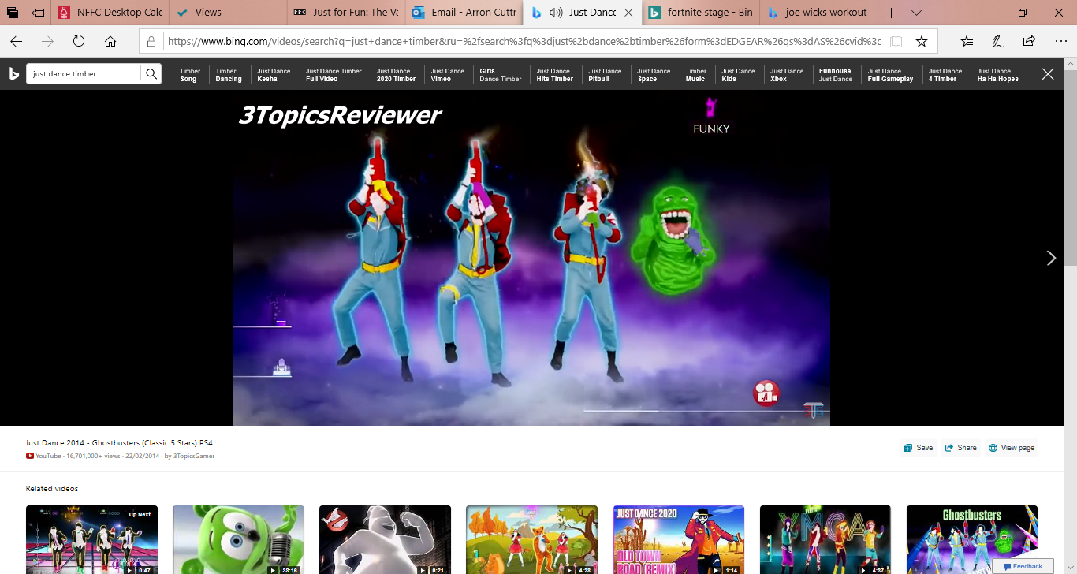
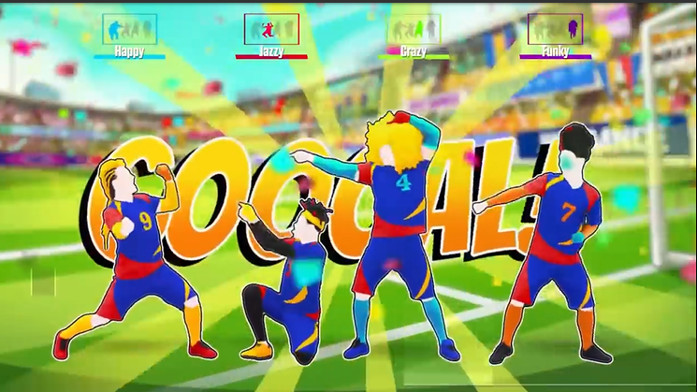
Grab a partner & Just Dance!
Here's a few dances for you to have ago at yourself, choose a character, grab a relative and get them join in with you!

Slide 9

WELL DONE YOU WERE BRILLIANT!!
I’m hearing you scored 10’s all round, the judges were impressed!
- Remember to keep active as best you can, its important we aim to get one hour of exercise a day, try the links below to keep you active while at home
https://www.youtube.com/watch?v=Kyv9iJf0gT8
https://www.youtube.com/watch?v=Rizij3icAOU
https://www.youtube.com/watch?v=lDA8QqF5gtM

Slide 10


